Slide 1
Jupyter Notebooks basics
Data types
Variables

Slide 2

We will be using
Python is an object-oriented programming language
User friendly: Easier to read, write, and maintain because the programmer uses simple syntax
Open-source (free for everyone!)
The most widely used data science programming language in the world
Used for web development, game development, data analysis

Slide 3




We will be using Jupyter Notebooks
Web-based interactive programming platform
Combine Python code and Markdown text in a notebook
It is an acronym for Julia, Python and R programming languages, which the notebooks support
https://jupyter-notebook.readthedocs.io/en/stable/index.html

Slide 4
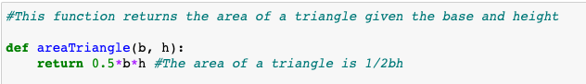
Comment
A remark made by the programmer explaining their code
Begins with the hash (#) symbol
Does not affect the code

Slide 5
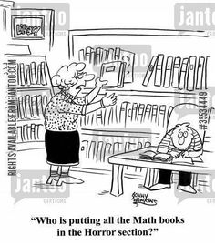




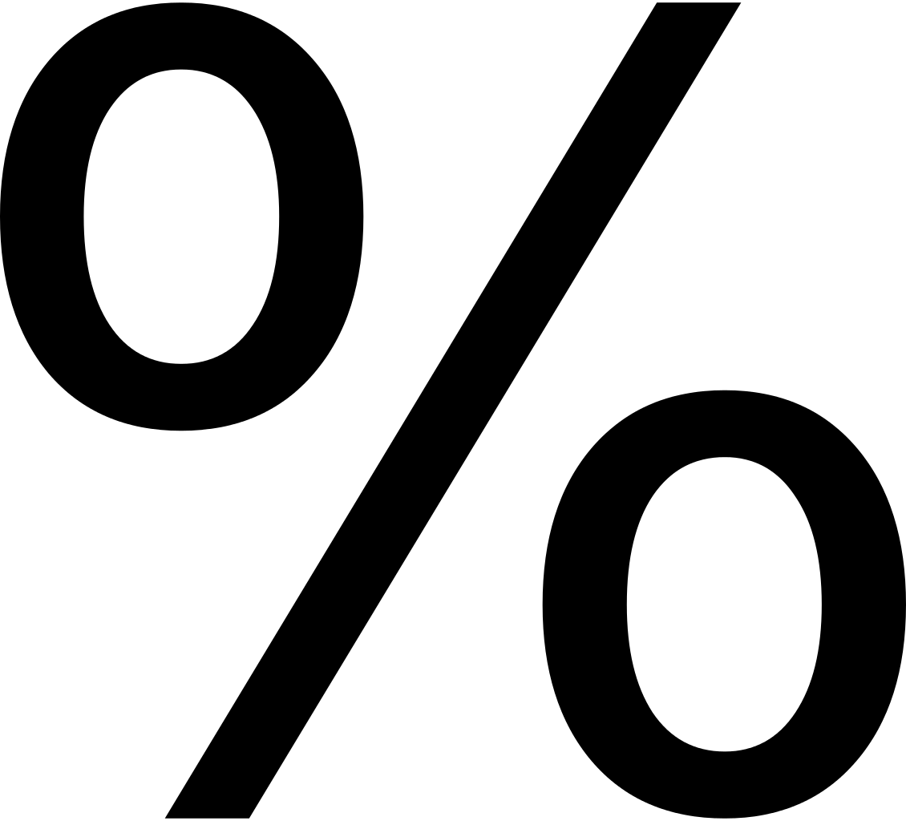

Arithmetic Operators
Operator | Name | Example
 | Addition | x + y
 | Subtraction | x - y
 | Multiplication | x * y
 | Division | x / y
 | Modulus | x % y
 | Exponentiation | x ** y
 | Floor division | x // y
Notes:
Note: Floor division is when you take a float and round it down to the nearest integer. 3/2 = 1.5 but 3//2 = 1
Modulus is calculating the remainder of a division. 5/2 = 2.5 but 5%2 = 1

Slide 6
Numeric Data Types: Integer vs. Float
Integer (int) | Float (float)
3, 45, 67 | 3.0, 4.1, 5.8
Integers are whole numbers
Floats contain a decimal point
You can convert from a float to an integer using floor division (//) which will always round down
Ex. 3/2 = 1.5, 3//2 = 1
Ex. 4//5 = 0
Notes:
There is also complex (e.g. 3 + 5j)

Slide 7

String (str)
Sequence of characters
Holds textual data
Encapsulated in quotation marks
Either single (‘’) or double (“”)
Ex. “Science”
Anything inside quotation marks will be read as a string, not anything else
For example: “2” in quotes is not the number 2, it is the character/symbol “2”
Notes:
Mention when it’s important to use single vs double quotes (apostrophe example)
Mention functions aren’t evaluated within strings

Slide 8
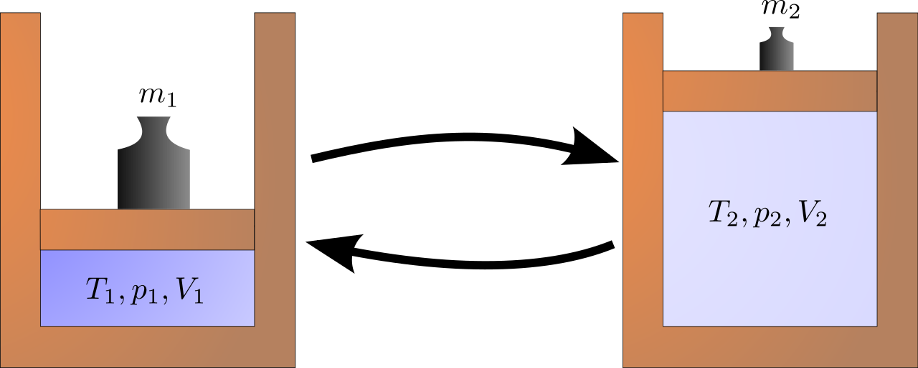
Type() Function and Type Conversion
The type() function displays the type of the object passed into it.
Type conversion/casting is a conversion from one type to another.
int(“2”) → 2
str(2) → “2”
int
str
Notes:
Example: type(5) = integer
Conversion will be covered when going through variables.

Slide 9

In notebook 00_intro_to_python, complete the following sections:
1.1 - Comments
1.2 - Adding and Deleting Cells
2.1 - Python for simple arithmetic
2.2 - Python for textual data

Slide 10
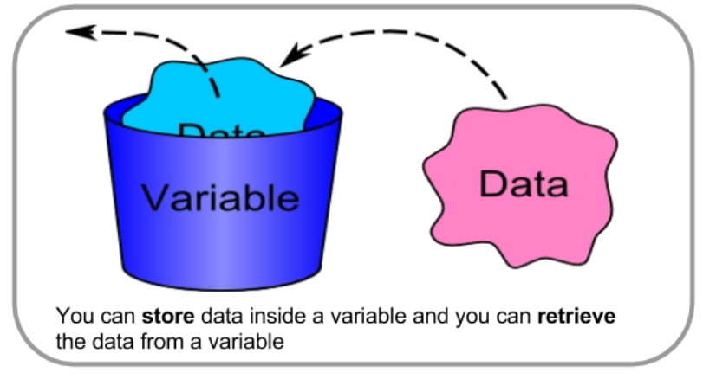
Variables
“Virtual boxes” that store values for reuse later
Certain rules:
Must begin with letters
Alphanumeric characters and underscores
Case sensitive
Use relevant variable names for documentation purposes — very important!!!
Ex. my_age = 16
Notes:
E.g Don’t name a variable that will store names “variable1”, etc.

Slide 11

Assignment Statement
a = 3
Value
“a” in this case is the variable
3 in this case is the value
Variable
Notes:
The variable “a” is assigned a value of (integer) 3

Slide 12
Example - Area of rectangle
What would the following code output?
width = 3
length = 2
print(width)
You can also do arithmetic with variables. What would the following code output?
area = width * length
print(area)

Slide 13
Assignment Statements - Challenge
a = 1
a = a + 3
What value does the variable ‘a’ have?
a = a + 3
a +=3
Note that is the same as
Notes:
You can use variables within statements
Can also do -, /, *

Slide 14
Assignment Statements - Challenge
a = 1
b = 2
a = a + 2*b
What value does the variable ‘a’ have?
Notes:
You can use variables within statements
Can also do -, /, *

Slide 15
In notebook 00_intro_to_python, complete the following section:
2.3 - Variables
When you are done, complete the Exit Ticket!
If you are done early, you can work on the Challenge (coding a game)

